Slide 1


2022
Engineering College Predictor based on TSEAMCET rank
Team Members:
R.V. Sai Sriram
C. Moses
P. Vignesh Reddy
G. Sai Kartheek
D. Sanjay Kumar
– 21BD1A053L
– 21BD1A052B
– 21BD1A053E
– 21BD1A052G
– 21BD1A052C
CSE-B
1 | P a g e
Computer Science Engineering Department, KMIT Engineering College

Slide 2
Acknowledgement
This is to acknowledge all those without whom this
project would not have been reality. Firstly, We would wish to thank our Computer science – phython programming Lecturer Sri. David Raju Garu, who gave his immense support, dedicated his time towards it and made us understand how to make this project. Without his guidance, the project would not have been complete.

Slide 3
Table of Contents
Abstract and Problem Definition
Python – An Introduction
Data flow diagram of implementation
CSV file handling in python
Matplotlib() for data visualization
Pandas
Results and Conclusion

Slide 4
1. Abstract
Every year several students in pursue of their academic career appear for the TSEAMCET and after getting a good rank aspire for joining a good college. Due to web options and online counselling, students will be eager to know the choice of their colleges based on the rank. Hence, the prediction of possible college for the year 2022 based on the previous year 2021 seat allotment in first and special rounds is implemented. The problem statement of the project is defined as:
Problem Definition
“To predict the possible engineering colleges that are likely to get for the EAMCET rank obtained, in a given branch for a given gender and reservation category for the year 2022 based on the previous year’s 2021 seat allotment”

Slide 5
2. Python – An introduction
What is Python?
Python is a popular programming language. It was created by Guido van Rossum, and released in 1991.
It is used for:
web development (server-side),
software development,
mathematics,
system scripting.
What can Python do?
Python can be used on a server to create web applications.
Python can be used alongside software to create workflows.
Python can connect to database systems. It can also read and modify files.
Python can be used to handle big data and perform complex mathematics.
Python can be used for rapid prototyping, or for production-ready software development.

Slide 6
3. Data flow diagram of implementation
The implementation of the project has been carried out by using the various programming features of python.
The Concepts Covered can be listed as:
Conditional statements
Loops
CSV file Handling python (reading and writing)
Writing a function and calling the function
File open, read and write operations
List creation, List sorting, List appending
PANDAS for data frame initialization
Matplotlib(), plot function for visualization
The stages in the project implementation can be categorized as
Data base creation for the First Round and Special Round admissions of 2021 EAMCET exam from https://tseamcet.nic.in, Converting the data into excel format and then converting into CSV format.
Importing the required library functions and initializing the variables used in the program.
CSV file reading and getting the user inputs like Rank, Reservation category, Branch etc.,
Based on the above inputs extraction of the data from the CSV file.
Writing the extracted data to output CSV file after formatting.
Reading the data into pandas data frame for visualization.
Using matplotlib() plot function displaying the results as line graph.
The various steps followed in the project implementation are shown in the Flow diagram below.

Slide 7
Importing Libraries
 | Variable’s initialization
 |  |  | Writing the data stored in list to a output CSV
file
 | CSV file reading
 |  |  | Writing the data in to a PANDAS Dataframe for
 |  |  | visualisation
 | Getting the user inputs like Rank, Gender, Branch etc
 |  |  | Visualisation of the data using matplotlib()
 | Based on the user inputs extraction of data from CSV | End
Sorting of the extracted data wrt best college option
Writing the sorted data to a list structure
Dataflow diagram of the project

Slide 8
4. CSV file handling in python
What is a CSV?
CSV (Comma Separated Values) is a simple file format used to store tabular data, such as a spreadsheet or database. A CSV file stores tabular data (numbers and text) in plain text. Each line of the file is a data record. Each record consists of one or more fields, separated by commas. The use of the comma as a field separator is the source of the name for this file format.
For working CSV files in Python, there is an inbuilt module called csv.
The so-called CSV (Comma Separated Values) format is the most common import and export format for spreadsheets and databases. CSV format was used for many years prior to attempts to describe the format in a standardized way in RFC 4180. The lack of a well-defined standard means that subtle differences often exist in the data produced and consumed by different applications. These differences can make it annoying to process CSV files from multiple sources. Still, while the delimiters and quoting characters vary, the overall format is similar enough that it is possible to write a single module which can efficiently manipulate such data, hiding the details of reading and writing the data from the programmer.
The csv module implements classes to read and write tabular data in CSV format. It allows programmers to say, “write this data in the format preferred by Excel,” or “read data from this file which was generated by Excel,” without knowing the precise details of the CSV format used by Excel. Programmers can also describe the CSV formats understood by other applications or define their own special-purpose CSV formats.
The csv module defines the following functions: csv.reader(csvfile, dialect='excel', **fmtparams) csv.writer(csvfile, dialect='excel', **fmtparams)¶

Slide 9
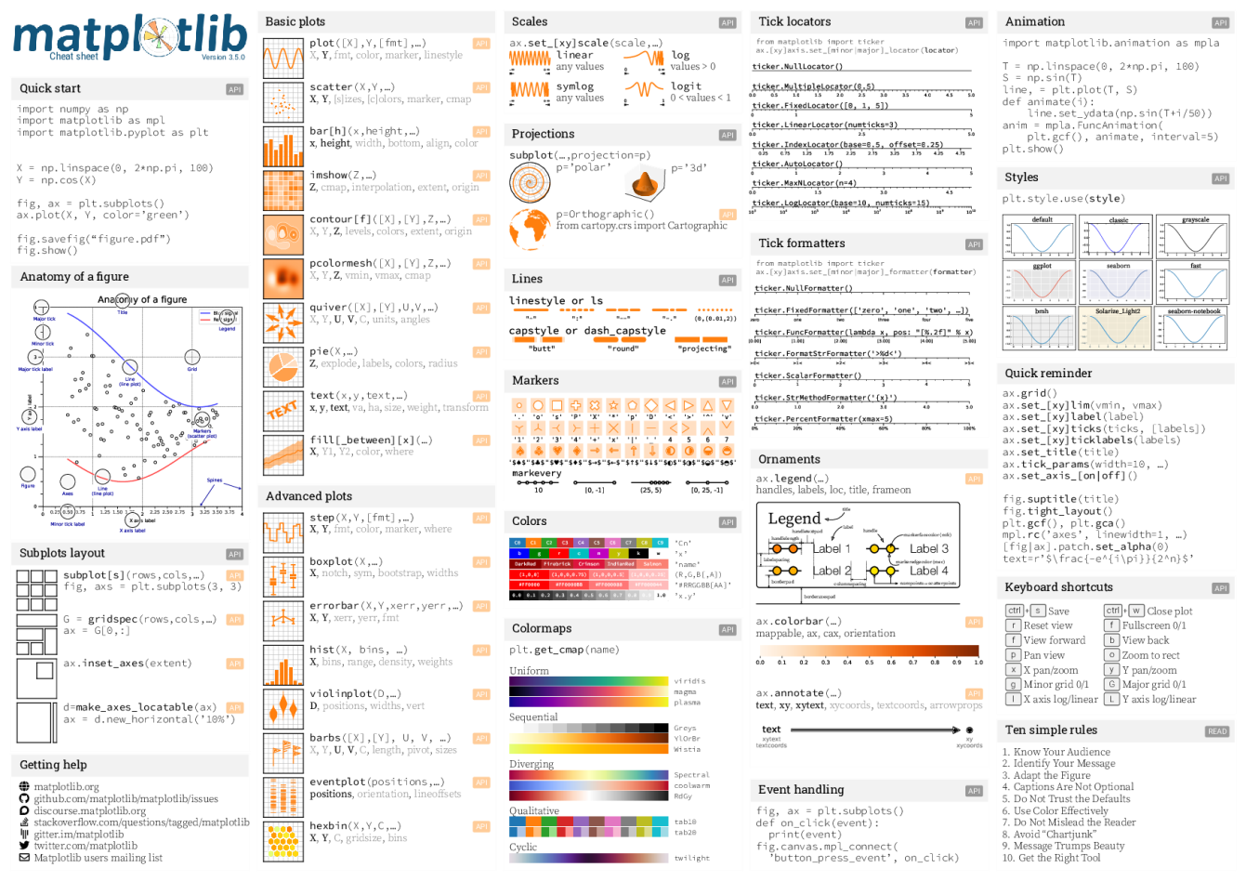
5. Matplotlib ()
Matplotlib is a comprehensive library for creating static, animated, and interactive visualizations in Python. Matplotlib makes easy things easy and hard things possible.
Create publication quality plots.
Make interactive figures that can zoom, pan, update.
Customize visual style and layout.
Export to many file formats.
Embed in JupyterLab and Graphical User Interfaces.
Use a rich array of third-party packages built on Matplotlib.

Slide 10
6. PANDAS
Pandas is a Python package providing fast, flexible, and expressive data structures designed to make working with “relational” or “labeled” data both easy and intuitive. It aims to be the fundamental high-level building block for doing practical, real-world data analysis in Python. Additionally, it has the broader goal of becoming the most powerful and flexible open source data analysis/manipulation tool available in any language. It is already well on its way toward this goal. pandas is well suited for many different kinds of data:
Tabular data with heterogeneously-typed columns, as in an SQL table or Excel spreadsheet
Ordered and unordered (not necessarily fixed-frequency) time series data.
Arbitrary matrix data (homogeneously typed or heterogeneous) with row and column labels
Any other form of observational / statistical data sets. The data need not be labeled at all to be placed into a pandas data structure.
The two primary data structures of pandas, Series (1-dimensional) and DataFrame (2- dimensional), handle the vast majority of typical use cases in finance, statistics, social science, and many areas of engineering. pandas is built on top of NumPy and is intended to integrate well within a scientific computing environment with many other 3rd party libraries.
Here are just a few of the things that pandas does well:
Easy handling of missing data (represented as NaN) in floating point as well as non- floating-point data
Size mutability: columns can be inserted and deleted from DataFrame and higher
dimensional objects
Automatic and explicit data alignment: objects can be explicitly aligned to a set of labels, or the user can simply ignore the labels and let Series, Data Frame, etc. automatically align the data for you in computations
Powerful, flexible group by functionality to perform split-apply-combine operations on data sets, for both aggregating and transforming data
Make it easy to convert ragged, differently-indexed data in other Python and NumPy data
structures into Data Frame objects
Intelligent label-based slicing, fancy indexing, and subsetting of large data sets
Intuitive merging and joining data sets
Flexible reshaping and pivoting of data sets
Hierarchical labeling of axes (possible to have multiple labels per tick)
Robust IO tools for loading data from flat files (CSV and delimited), Excel files, databases, and saving / loading data from the ultrafast HDF5 format
Time series-specific functionality: date range generation and frequency conversion,
moving window statistics, date shifting, and lagging.

Slide 11
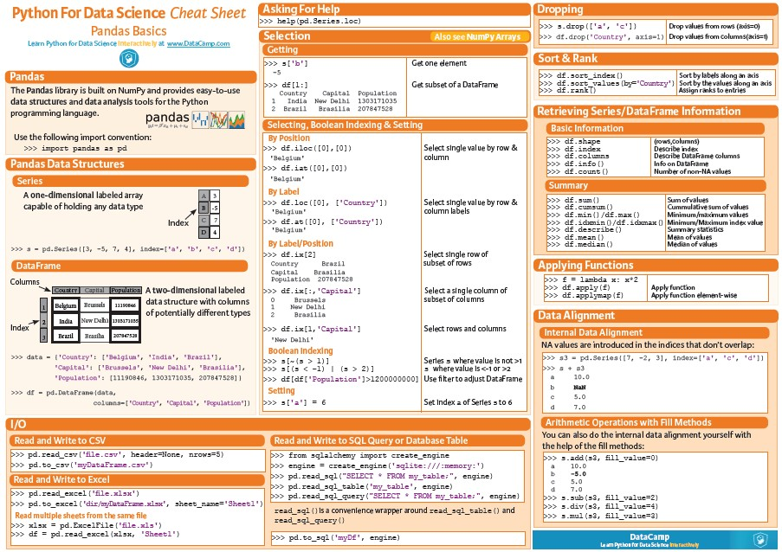

Slide 12
SOURCE CODE LISTING
import pandas as pd
import matplotlib.pyplot as plt import csv
csv_file_1stRound = open("/content/drive/MyDrive/Colab Notebooks/TSEAMCET_ 2021_LAST RANKS_FIRSTPHASE_CSV.csv")
data_1stRound=csv.reader(csv_file_1stRound,delimiter=',')
csv_file_2ndRound=open("/content/drive/MyDrive/Colab Notebooks/TSEAMCET_20 21_LAST RANKS_SPECIAL_ROUND_CSV.csv")
data_2ndRound=csv.reader(csv_file_2ndRound,delimiter=',')
rank = int(input("Enter the rank got in EAMCET: ")) print('\nCaste Gender options to chose from : ')
print('OC BOYS, OC GIRLS, BC_A BOYS, BC_A GIRLS, BC_B BOYS, BC_B GIRLS') print('BC_C BOYS, BC_C GIRLS,BC_D BOYS,BC_D GIRLS,BC_E BOYS,BC_E GIRLS') print('SC BOYS, SC GIRLS, ST BOYS, ST GIRLS, EWS GEN OU, EWS GIRLS OU')
caste_gender = input("Enter caste and gender from options above:") print('\nBranch options to chose from : ')
print('AGR, AI, AID, ANE, AUT, BME, CHE. CIC, CIV, CME, CSB, CSC, CSD, ')
print('CSE, CSI, CSM, CSN, CSO, CST, CSW, DRG, DTD, ECE, ECI, ECM, EEE') print('EIE, ETM, FDS, FPT, FSP, INF, ITE, MCT, MEC,, MET, MIN, MMS, MMT') print('MTE, PHE, PLG, TEX')
branch = input("Enter the branch you want to chose from options above: ") print('\n')
clglst = [] clglst_f = [] head_1 = [] head_2 = []
A=open("Rank_5536_CSE_Round1_options.csv")
# Function for extracting the college options -------------- def college_options(data_in,caste,branch_name,rank_EAMCET,num):
clglst1 = [] indx =[]
l = next(data_in) a = l.index(caste)
#institute name = 1, branch=7

Slide 13
indx.append([l[1],l[a],l[7]]) for row in data_in:
if branch_name in row[7]:
if row[a] != 'NA' and branch_name == row[7]:
if rank_EAMCET <= int(row[a]) and rank_EAMCET>0: #print(row[1], row[a],row[7])
num = num+1
clglst1.append([row[1], row[a],row[7]]) #print("Number of colleges suggested: ", num)
return [clglst1,indx,num]
# end of the function-
[clglst,head_1,iter_opt1] = college_options(data_1stRound,caste_gender,bra nch,rank,P)
print("Number of colleges suggested for 1st Round of counselling: ",iter_o pt1)
[clglst_f,head_2,iter_opt2] = college_options(data_2ndRound,caste_gender,b ranch,rank,Q)
print("Number of colleges suggested for Special Round of counselling: ",it er_opt2)
fname_1st = 'Rank_'+str(rank)+'_'+branch+'_Round1_options.csv' file_1st = open(fname_1st, 'w+', newline ='')
fname_2nd = 'Rank_'+str(rank)+'_'+branch+'_Round2_options.csv' file_2nd = open(fname_2nd, 'w+', newline ='')
print("First round Colleges are written to file :", fname_1st,' in current directory \n')
print("Special round Colleges are written to file : ", fname_2nd,' in curr ent directory \n')
# writing the data into the file with file_1st:
write = csv.writer(file_1st) write.writerows(head_1)
write.writerows(sorted(clglst, key=lambda x: int(x[1])))
# writing the data into the file with file_2nd:
write = csv.writer(file_2nd) write.writerows(head_2)
write.writerows(sorted(clglst_f, key=lambda x: int(x[1])))

Slide 14
csv_file_1st = open(fname_1st) csv_file_2nd = open(fname_2nd)
#create DataFrame from list
options_1st = pd.read_csv(csv_file_1st)
pl_opt = options_1st[1:11] #create DataFrame from list
options_2nd = pd.read_csv(csv_file_2nd)
pl_opt2 = options_2nd[1:11] print(pl_opt2)
col_header = pl_opt.columns.tolist() col_header2 = pl_opt2.columns.tolist()
plt.figure(figsize=(24, 6)) plt.subplot(1,2,1)
plt.plot(pl_opt[col_header[0]],pl_opt[col_header[1]],label='1st Round',col or='green')
plt.xticks(rotation=90)
Titl = "1st Round for "+caste_gender+' in '+branch+' branch for Top 10 col leges'
plt.title(Titl) plt.xlabel('INSTITUTE NAME')
plt.ylabel(caste_gender+' RANK')
plt.subplot(1,2,2) plt.plot(pl_opt2[col_header2[0]],pl_opt2[col_header2[1]],label='Special Ro und',color='purple')
plt.xticks(rotation=90)
Titl = "Spl Round for "+caste_gender+' in '+branch+' branch for Top 10 col leges'
plt.title(Titl) plt.xlabel('INSTITUTE NAME') plt.ylabel(caste_gender+' RANK')
# End of the program

Slide 15
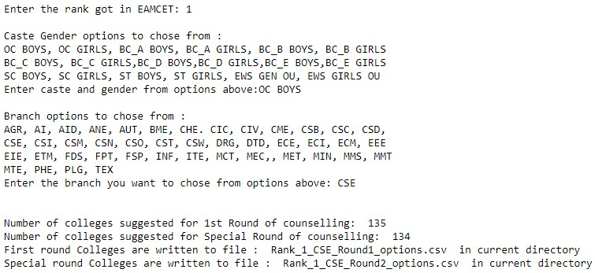
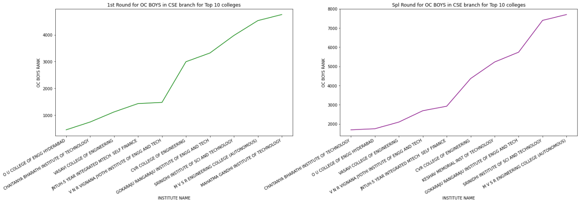
Sample output
For e.g., For OC BOYS category, CSE Branch the following are the programs outcome suggestions:
Rank 1
Rank 1000
: 135/134 colleges
: 132/134 colleges

Slide 16
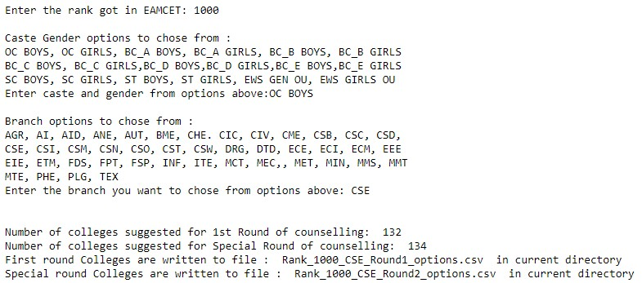
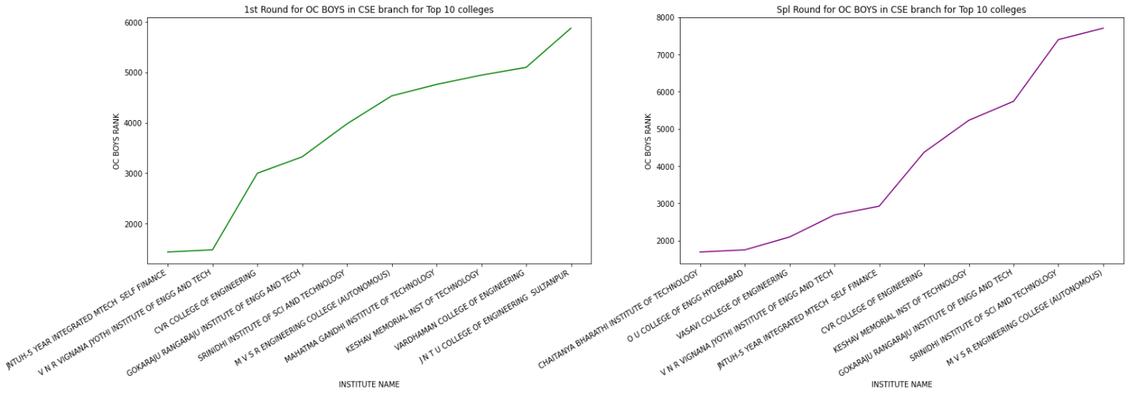
Rank 10000
Rank 50000
: 114/119 colleges
: 40/44 colleges

Slide 17
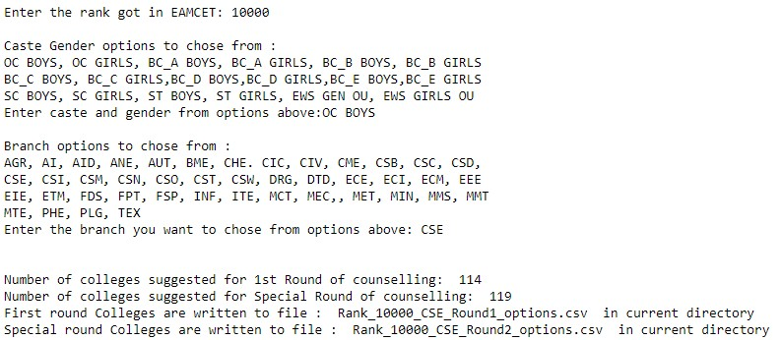
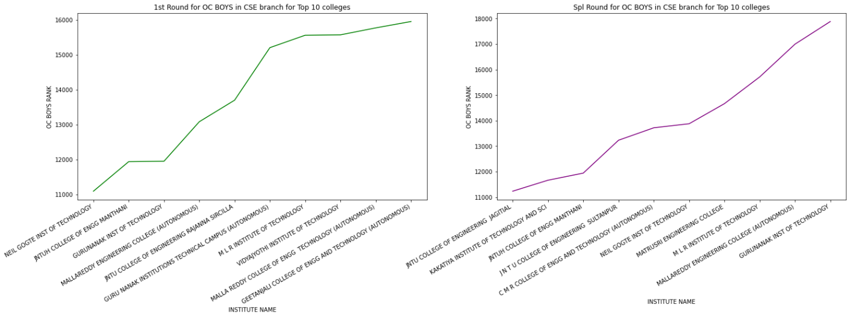

Slide 18
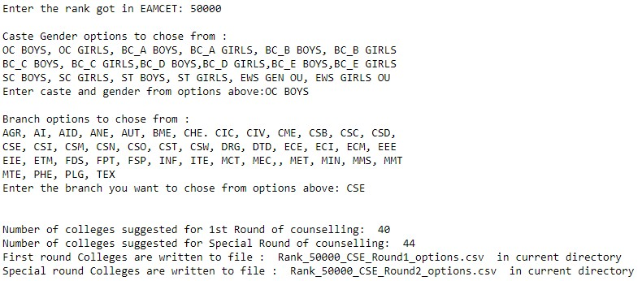
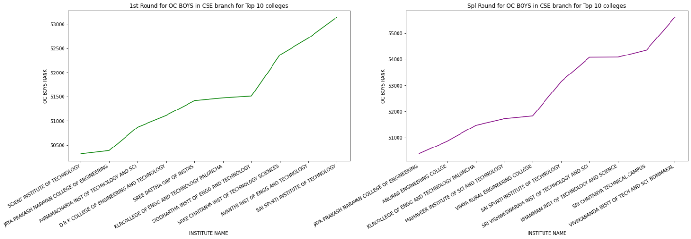

Slide 19
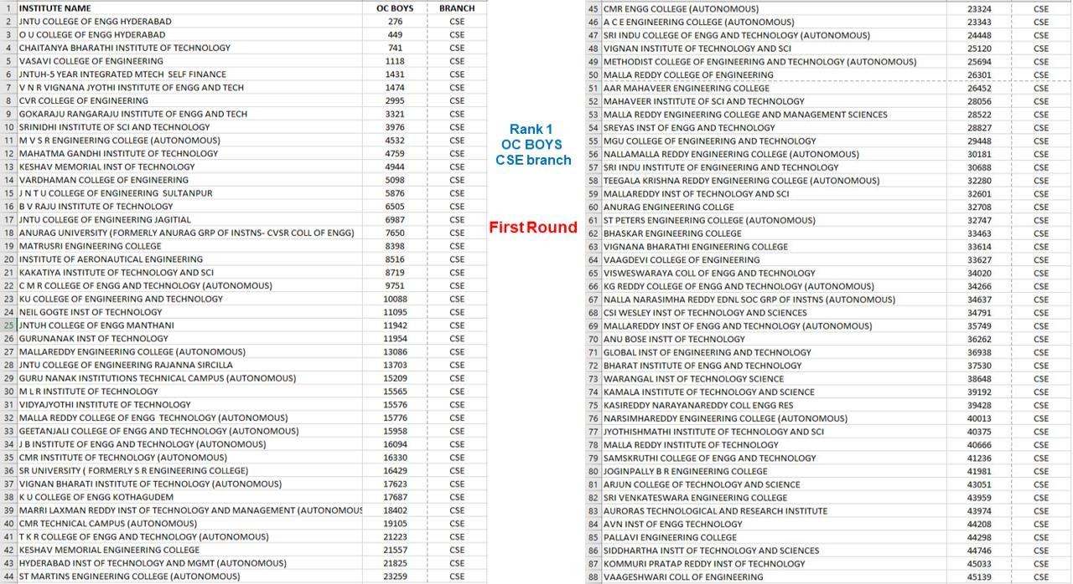
CSV File outputs

Slide 20
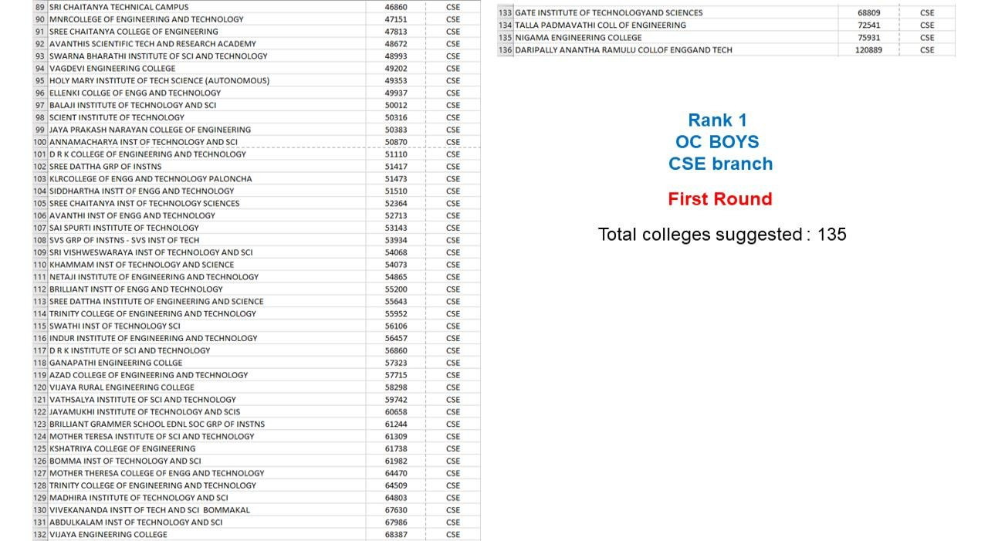
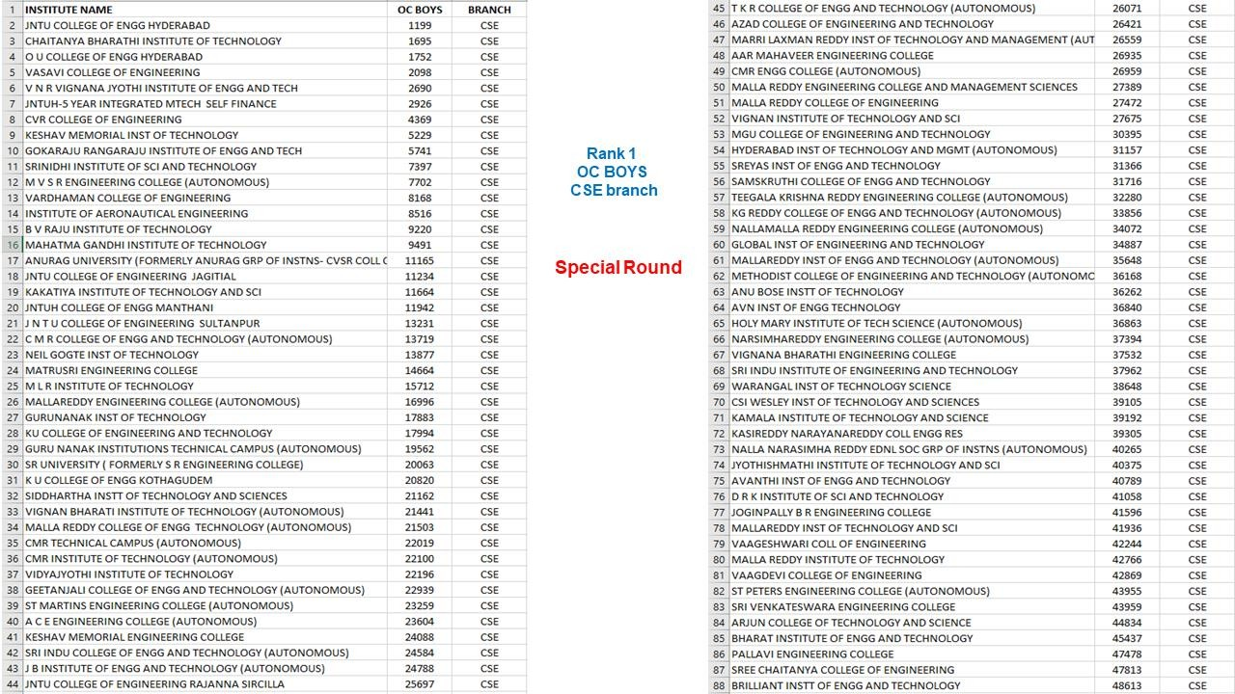

Slide 21
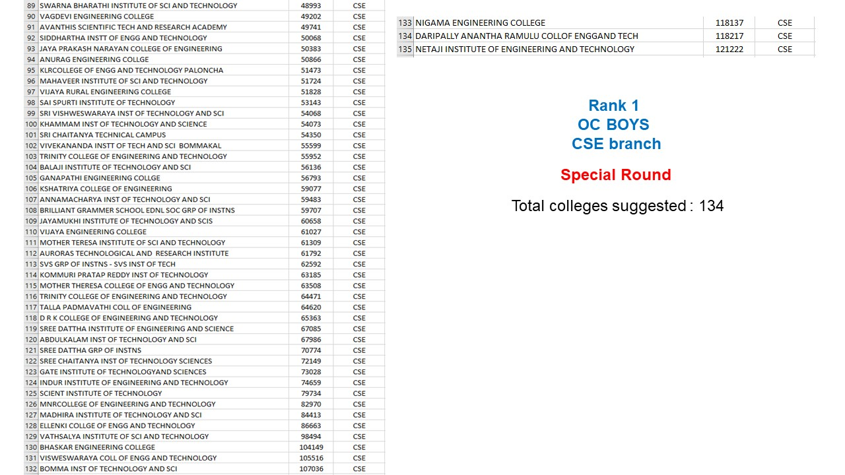

Slide 22
CONCLUSION
In this project we made a code which takes rank and other details as input and predicts the colleges and suggest best colleges based on given rank
CLICK HERE
References
https://tseamcet.nic.in
Python programming tutorials from Datacamp and W3C Schools
KMIT Python study material
TS Eamcet 2021 first phase ranks
TS Eamcet 2021 special round ranks

